Slide 1
Determining the Cost to Move to Azure

Slide 2



About Me
Director of Data Management for LifePoint Health
Email - Dorsey.Dustin@att.net
LinkedIn – linkedin.com/in/dustindorsey
Twitter - @SQL_DD
Blog - https://dustindorsey.com/
Github - https://github.com/dustin-dorsey
I have been working with SQL Server for over a decade
Active speaker and struggling blogger
Notes:
Agenda

Slide 3
Agenda
Discuss why we should care about cost management
Discuss how you can determine the cost for your move to Azure
Discuss considerations\gotchas along the way
Notes:
Agenda

Slide 4

Why Should You Care?
Costs is one of the leading factors that
keep people from moving to the cloud or influence their decision to move out
Notes:
According to a recent survey by IHS and Fortinet, 74% of 350 Enterprise companies they polled stated they moved back to on-premise. One of the reasons is the cost-effectiveness
https://www.fortinet.com/blog/industry-trends/ihs-markit-fortinet-cloud-report-insights.html
IDC reported 81% … 85% of these planning to move more
Managing and controlling costs is one of the top data management priorities as listed by half of the companies surveyed

Slide 5
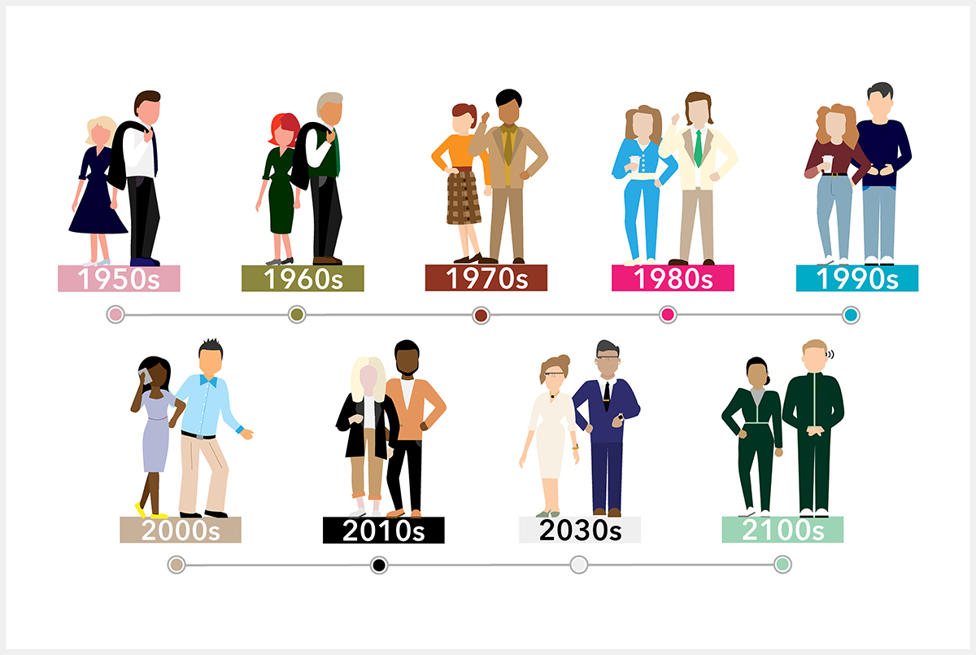
The Evolution of the DBA\Data Professional
Notes:
SQL Server 1.0 released in 1989 (around 20 Versions released since)
As the product\technology has gone through shifts, our roles has changed
Microsoft Azure released on Feb 1, 2010
* Cloud adoption rate is growing

Slide 6

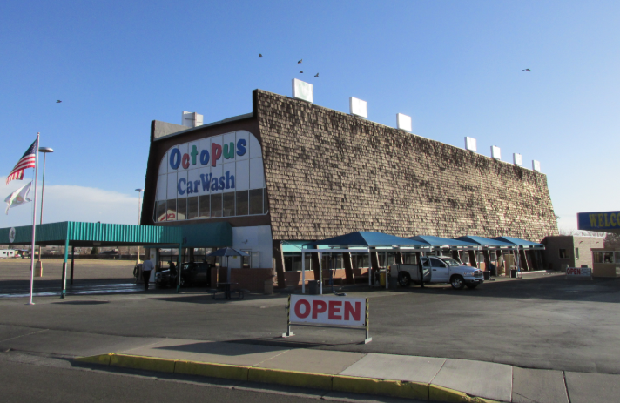
Cost Management is REALLY Important!
Notes:
Paying for what you consume
Controlling spends in Azure.
Being knowledgeable about the costs and how it translates to your systems
Architecting systems that are in line with your company’s budgets and expectations
Architecture and cost go hand-in-hand in Azure
Skills of DBA translates (performance tuning)

Slide 7

Benefits of the Cloud
Faster time to deployment
Ability to scale up and down
Pay for what you use
Security
Accessibility
Simplified Administration
Improved HA\DR
Stay on latest technology
Controlled and manageable costs
Notes:
Its NOT always cheaper!

Slide 8
Myths About Azure (in terms of costs)
Myth 1: Lifting and shifting my entire infrastructure will result in significant cost savings
Myth 2: Cloud is cheaper them on-prem hardware
Myth 3: I just need to get on the cloud and watch the savings roll in

Slide 9

Costs of Azure
The tools and information are available for you to estimate your cost to move to Azure and your run rate while there, although it does require some planning and work… There is not an easy button for this.
Notes:
It is not that difficult to do, but it does require some time to invest in it

Slide 10
Suggestions on How to Get Started
Start getting familiar with Azure
Utilize free credits or set aside a small budget
Work with Microsoft as a partner.
They want you to succeed!
Consider working with a reputable 3rd party
Start slow and with light workloads
Learn the tools available
Notes:
1. Use free credits to get yourself familiar with the Azure components you plan to use. Use them and watch how certain decisions you make affect the pricing. Getting as comfortable as you can is key. You can use estimation tools, speak to people, etc. but nothing beats getting familiar yourself
2. Work with Microsoft as a partner. They are heavily invested in making sure you succeed, think of them as an extension of your team.
3. Consider also working with a reputable 3rd party to get started (there are several). This will require some additional costs up front, but can save you some headache\money down the road. This can also be critical if you have a timeline to complete it
4. Do not try to rush into it or you could miss important things and start with moving small workloads. With these less risks is involved and gives you an opportunity to get comfortable (workload, performance, pricing, management, etc.) and keeps the cost of mistakes made a lower cost. With lighter workloads it’s a lot easier\more cost-effective to move back on-prem if there is a reason you need to

Slide 11
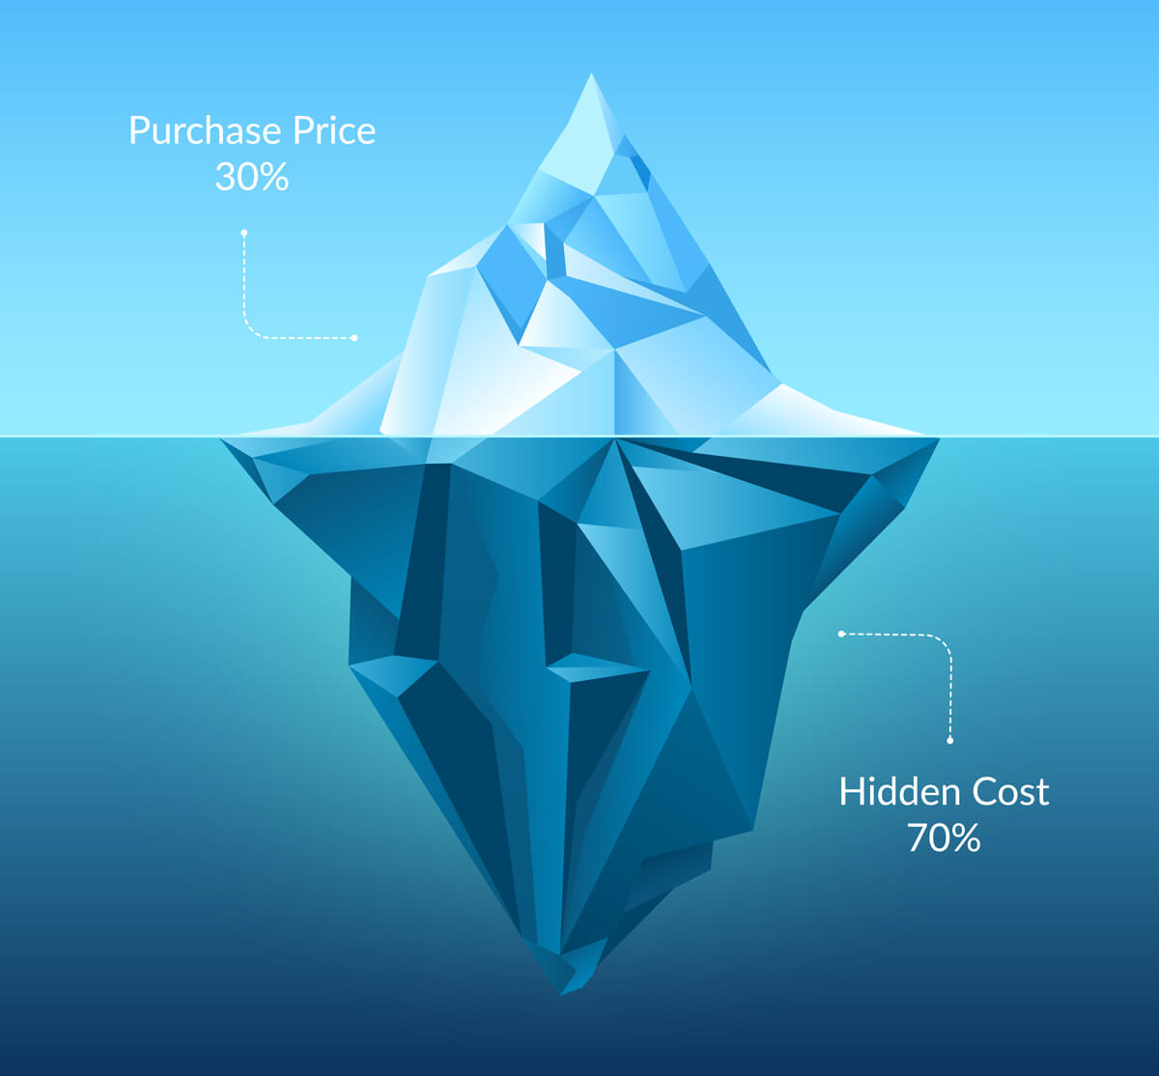
Total Cost of Ownership (TCO) Calculator
The tool allows you to estimate the cost savings you can realize by migrating your workloads to the cloud
https://azure.microsoft.com/en-us/pricing/tco/calculator/
Notes:
This can assist with building ROI and making the case for that
Used to realize potential savings of on-prem vs the cloud. The problem with this tool it is very time-consuming (both in entering the data and collecting it) to try to build an accurate estimate, although if you spend the time it returns some great data and fantastic charts that you can share with the business

Slide 12

Azure Calculator
The Azure calculator is a tool that allows you to better understand your costs to operate in the cloud
https://azure.microsoft.com/en-us/pricing/calculator/
Notes:
This tool allows you to determine your run rate in Azure
Do DEMO of this tool

Slide 13
Demo of Azure Calculator
Notes:
This tool allows you to determine your run rate in Azure
Do DEMO of this tool
Building a price estimate
Labeling
Cloning items
Exporting the results

Slide 14
Important Considerations for this Calculator
Try not to underestimate
Something small can add up to a lot
Do not guess
Back up what you are entering with data
The calculator does not tell you which products have dependencies on others
Hit the SAVE button when you are making changes
Use it throughout the analysis process
Data is exportable
Egress is not factored
Notes:
Important things to remember with the calculator:
Try not to underestimate when using the calculator. Small costs that you can overlook can add up to a lot. It’s better to overestimate and avoid price shock later.
2. Avoid GUESSING! If you do not know, check. Everything you add there should be backed up with data
3. The Azure calculator does not tell you which products have dependencies on others. You need to do your research and make sure you are including everything.
4. Hit the SAVE button when you add things…. The most important button on the calculator
5. Use it throughout the analysis process…. Things will change
6. Add 20% to your cost for your budget… Or at least make sure that is not a dealbreaker. Things can and will change once you start implementing

Slide 15
Use the Calculator to the MAX
Calculate
Create estimates and experiment
Evaluate
Review often and ask yourself questions throughout the process
Infiltrate
Understand the product the best you can
Notes:
Use the Azure Calculator to the MAX. Create estimates, manipulate, clone, experiment, etc. and take time to step back and evaluate. Ask yourselves the questions of where will change have an impact, what needs a different approach, how can cost be optimized, and why does this add value to the organization? And lastly, get comfortable with Azure. Its all about the detail, know it inside and out, the options, the limits, the products, and most importantly the cost.
· Calculate
· Evaluate
· Infiltrate

Slide 16

Big SCARY Egress
When moving a workload to Azure, you really need to consider how much data will be leaving Azure
Evaluate dependencies
Notes:
Let's talk about some major cost considerations
8.7 cents per GB < 10 TB --- $870

Slide 17
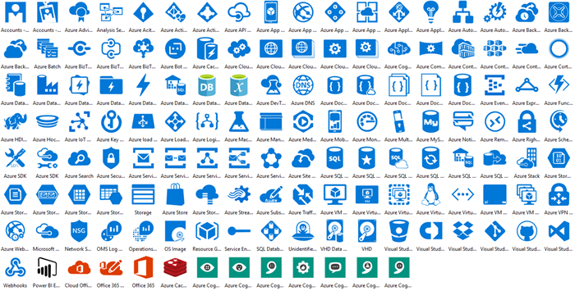
Determine Your Architecture
Notes:
What products are you going to use? And understand your costs associated with each?

Slide 18

Planning For Future Growth

Slide 19
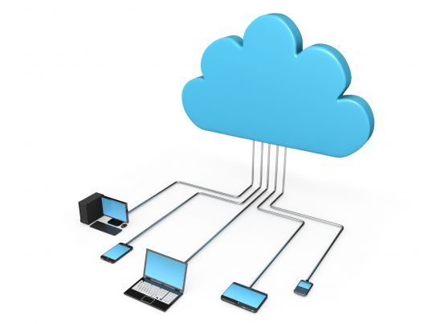
Networking Considerations that Impact Cost
Latency
Data Transfers
Bandwidth
Runtime
External Connections
Notes:
Networking things to consider that impact cost:
· Latency and how it may affect the end user experience. Determine what location you plan to use.
* Note: The nearest Azure data center may not necessarily provide the lowest latency
* Note: There can also be a slight cost difference on costs in different regions
* There are some good tools to determine latency from your location to the Azure data centers that you can use as a guide
* Azurespeed – shows network latency in real time from your IP location
* Azurespeedtest – measures your latency to Blob storage
·Need to understand data transfers as this has an associated cost
* No cost for inbound, but there is a charge for outbound
* You probably want to try to gain some insight into the volume of network traffic that will travel across your VPN connection
· Need to determine how much bandwidth you need… What is the volume of expected network traffic generated
· Does this need to be running all the time? Or what is the runtime.
· Are you working with external connections where you may need a B2B VPN?

Slide 20
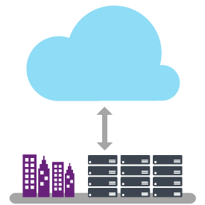
ExpressRoute
ExpressRoute is a service that enables you to create private connections between Azure datacenters and infrastructure that's on your premises or in a colocation environment.
Notes:
Will you need ExpressRoute now or in the future? Use Azure ExpressRoute to create private connections between Azure datacenters and infrastructure on your premises or in a colocation environment. ExpressRoute connections don't go over the public Internet, and they offer more reliability, faster speeds, and lower latencies than typical Internet connections. In some cases, using ExpressRoute connections to transfer data between on-premises systems and Azure can give you significant cost benefits. With ExpressRoute, establish connections to Azure at an ExpressRoute location, such as an Exchange provider facility, or directly connect to Azure from your existing WAN network, such as a multiprotocol label switching (MPLS) VPN, provided by a network service provider.
ExpressRoute is a service that enables you to create private connections between Azure datacenters and infrastructure that's on your premises or in a colocation environment.

Slide 21

Translating On-prem to the Cloud
Understand existing workloads
Only use what you need in the cloud. Your systems should be consuming most of the resources allocated.

Slide 22

Baseline Performance
Make sure your workload in the cloud performs as expected. Do comparisons to understand how it translates.

Slide 23

Tips to Help Lower Costs
Utilize reserved pricing
Azure Hybrid Benefit
Manage runtime hours
Stop to think if there is a better way to do this
Remove\turn off things you do not need
Take advantage of offered Microsoft Programs
Utilize Dev\Test Pricing
Notes:
Ways to control costs:
Utilize reserved pricing (commitment of 1 or 3 years) can have significant cost savings.
2. Azure Hybrid Benefit – This allows you to bring on-prem Windows and SQL licenses to the cloud
a. Must have software assurance
b. Are the license on a volume licensing program and will it continue to be renewed? This may depend on whether you plan to move everything to cloud or run hybrid. If you run hybrid then, hybrid benefit is a great advantage
c. There are some conversions made for Windows licenses from on-prem to the cloud
3. Use running hours as a way to control cost. By default everything is 730 hours a month which means 24/7.
a. Use Start\Stop to create automated schedules to turn off things when they are not being used
4. Really consider what you are building and if there is better way. If you are building a VM is there an opportunity to take advantage of a Paas offering.
5. Remove\turn off things you not need
* Be sure to look back on unused resources in Azure to make sure you are not paying for things you are not using. Have seen virtual machines get deleted, but the disks and stored data remain active which incurs obsolete costs. Public IP’s no longer attached to anything can also incur charges. Old objects, evens ones without a cost, can still create a cluster

Slide 24
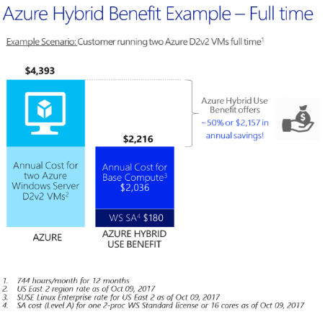
Azure Hybrid Benefit
Is a pricing offer that allows you to take your existing on-prem licenses for Windows and SQL Server to Azure
Azure Hybrid Benefit Calculator
https://azure.microsoft.com/en-us/pricing/hybrid-benefit/
Notes:
https://docs.microsoft.com/en-us/windows-server/get-started/azure-hybrid-benefit

Slide 25
Important Notes About SQL Azure Hybrid Benefit
All on-prem rules still apply unless specifically noted
1 Enterprise license (2 Cores) = 4 Standard licenses (8 cores) for general purpose (x4 multiplier)
Standard licenses are 1:1
1 Enterprise license (2 Cores) = 1 Enterprise licenses (2 Cores) for business critical
Cannot use Standard licenses for business critical
180 days of dual use for migration purposes only
HA/passive rules still apply
Must have SA to move licenses to Azure and must maintain it to retain this benefit
Option to use host-based licensing with Azure Dedicated Host (currently in Preview)
Notes:
1 Enterprise license (2 Cores) = 4 Standard licenses (8 cores) for general purpose (x4 multiplier)
1 Enterprise license (2 Cores) = 1 Enterprise licenses (2 Cores) for business critical
180 days of dual use for migration purposes only
License cannot be reassigned for 90 days
HA/passive rules still apply
Must have SA to move licenses to Azure and must maintain it to retain this benefit
Azure Dedicated Host - Currently in Preview

Slide 26
DTU vs vCore
 | DTU | vCore
Description | Blended measure of CPU, Memory and IO | Virtual Core
Pricing | Per Database, fixed price for compute, backup and storage | Per Database, separate charges for your compute and storage
Benefits | Simpler option. One fixed price includes everything | More options, but gives you more flexibility and transparency into what you are paying for
Base Model | Offers more lower end performance options | 2 cores
Licensing | Licensing included | Use Azure Hybrid Benefit to save
Tiers | Basic, Standard, Premium | General Purpose, Hyperscale, Business Critical (Gen 4 & Gen 5)
Notes:
DTU – Blended measure of CPU, Memory and IO
vCore – Is similar to assigning Cores for your on-prem systems. This was introduced as a simpler way
Which one is best can largely depend on your situation? Hard to quantify, so my recommendation is to test
* There is no communication that is indicating DTU will go away at this time although vCore seems to be the preferred.
You can swap between these without taking an outage.

Slide 27
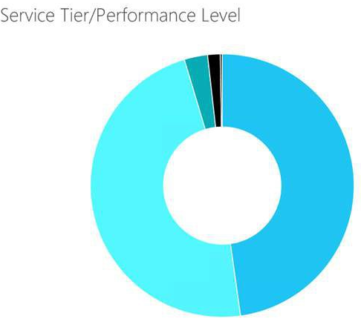
Azure SQL Database DTU Calculator
A tool that helps us determine the number of DTUs needed and what Tier. Also, can evaluate multiple workloads for Elastic Pools
https://dtucalculator.azurewebsites.net/

Slide 28

Azure SQL Database DTU Calculator (cont’d)
If you are using SentryOne as your monitoring tool and plan to use this calculator, check out this blog post on how you can take advantage of data already being collected
https://sqlperformance.com/2019/04/sql-performance/sending-sentryone-data-to-azure-sql-database-dtu-calculator

Slide 29
The Non-Azure Factors
Monitoring tools
Additional software (Iaas)
If your applications are supported in the cloud and if application licenses are transferrable
Compatibility of network hardware\services to the Azure gateways
Training for your staff
Notes:
3rd party costs - There are costs outside of Azure that you need to you need to also consider as part of your project
·
Monitoring tools
o Security, performance, etc.
· Security – Costs to protect user identities and devices
· Applications you are moving are supported in the cloud and licenses are transferrable (ie Legacy systems)
o Plans to continue to run on-prem
o Or retire the app and move to a new one, but this incurs cost
· Compatibility of network hardware\services to the Azure VPN gateways need to be verified

Slide 30

Selling to Your Business: Building Your ROI
Comparing on-prem costs to estimated cloud costs
Shift from Capital (CapEx) to Operating (OpEx)
Utilization
Time Reduction
Scale
Quality
Notes:
Comparing on-prem costs to estimated cloud costs
TCO calculator or manually looking at some of the big items you are paying for
Azure calculator (estimated cost to run in Azure)
Shift from CapEx to Opex
In cloud, you only pay for what you need so no large capital investments in hardware that requires you to overprovision for growth over X years
Utilization – How much are you consuming? Pay for what you need
Time Reduction – Quicker turnarounds\ Quicker on-boarding\off-boarding of business assets
Scale – Ability to scale on-demand without large capital investments
Quality – Availability, reliability, recoverability, responsiveness and throughput

Slide 31
Questions?

Slide 32
Major Cost Considerations
Costs for establishing network connectivity
Pricing for running your workloads
Determine which products to use and when
Iaas vs Paas
The non-Azure factors
Planning for future growth
Notes:
Here are some major considerations in regard to pricing that you will need to consider
1. Costs for establishing network connectivity
2. Pricing for running your workloads
3. Determining which product to use and when
4. The non-Azure costs
5. Planning for future growth

Slide 33
Networking Considerations that Impact Cost
Consider latency and how it may affect the end user experience
Understand data transfers as this has associated cost
Determine how much bandwidth
Is ExpressRoute needed?
How often does it need to be running?
Are you working with external connections?
Notes:
Networking things to consider that impact cost:
· Latency and how it may affect the end user experience. Determine what location you plan to use.
* Note: The nearest Azure data center may not necessarily provide the lowest latency
* Note: There can also be a slight cost difference on costs in different regions
* There are some good tools to determine latency from your location to the Azure data centers that you can use as a guide
* Azurespeed – shows network latency in real time from your IP location
* Azurespeedtest – measures your latency to Blob storage
·Need to understand data transfers as this has an associated cost
* No cost for inbound, but there is a charge for outbound
* You probably want to try to gain some insight into the volume of network traffic that will travel across your VPN connection
· Need to determine how much bandwidth you need… What is the volume of expected network traffic generated
· Does this need to be running all the time? Or what is the runtime.
· Are you working with external connections where you may need a B2B VPN?

